Slide 1
AZ-400.00 Module 6: Implementing Continuous Integration using Azure Pipelines

Slide 2
Lesson 01: Module overview

Slide 3
Module overview
Lesson 1: Module overview
Lesson 5: Integrating external source control with Azure Pipelines
Lesson 2: Continuous integration overview
Lesson 6: Set up self-hosted agents
Lesson 3: Implementing a build strategy
Lesson 7: Labs
Lesson 4: Integration with Azure Pipelines
Lesson 8: Module review and takeaways

Slide 4
Learning objectives
After completing this module, students will be able to:
Explain why continuous integration matters
Implement continuous integration using Azure DevOps

Slide 5

Lesson 02: Continuous integration overview

Slide 6
Introduction to continuous integration
Continuous integration (CI) is the process of automating the build and testing of code
CI encourages developers to share their code and unit tests by merging their changes into the shared version control repository
When a change is detected, it triggers an automated build system. The code is built using a build definition. Developers respond to any issues or bugs
CI keeps the master branch clean ensuring bugs are caught earlier in the development cycle, which makes them less expensive to fix

Slide 7
The four pillars of continuous integration
Continuous integration
Version control system
Package management system
Continuous integration system
Automated build process
A version control system manages changes to your source code over time.
A package management system is used to install, uninstall, and manage software packages.
A continuous integration system merges all developer working copies to a shared mainline several times a day.
An automated build process creates a software build including compiling, packaging, and running automated tests.
Notes:
Cover the software examples shown in the student materials.

Slide 8
Benefits of continuous integration
Improving code quality based on rapid feedback
Triggering automated testing for every code change
Reducing build times for rapid feedback and early detection of problems (risk reduction)
Better management of technical debt and code analysis
Reducing long, difficult, and bug-inducing merges
Increasing confidence in codebase health long before production deployment
Rapid feedback to the developer
Notes:
✔️ Continuous integration also enables tracking metrics to assess code quality over time, such as unit test pass rates, code that breaks frequently, code coverage trends, and code analysis. It can be used to provide information on what has been changed between builds for traceability benefits, as well as for introducing evidence of what teams do in order to have a global view of build results.
For more information, you can see: What is Continuous Integration? - https://docs.microsoft.com/en-us/azure/devops/learn/what-is-continuous-integration

Slide 9

Discussion: continuous integration
Have you tried to implement continuous integration in your organization?
If you were successful, what lessons did you learn?
If you were not successful, what were the challenges?

Slide 10
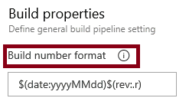
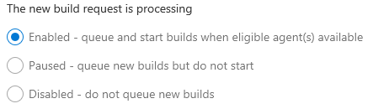
Build number formatting and build status
Build number formatting
Build status (enabled, paused, disabled)

Slide 11
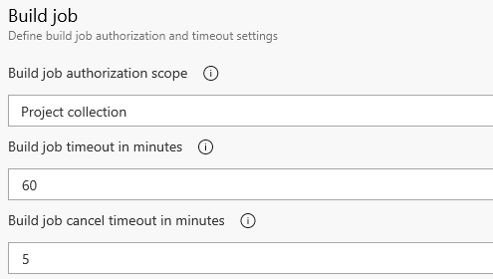

Authorization and timeouts, and badges
Authorization and timeouts (scope, job timeout, cancel job timeout)
Badges
Notes:
For more information, you can see:
Build Pipeline Options - https://docs.microsoft.com/en-us/azure/devops/pipelines/build/options?view=vsts&tabs=yaml

Slide 12

Lesson 03: Implementing a build strategy

Slide 13
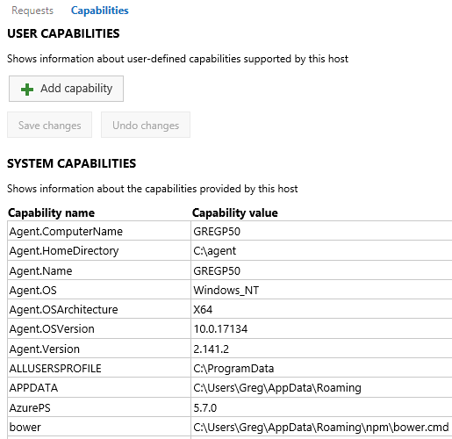
Configuring agent demands
User capabilities
System capabilities
Agents can have different authorization and timeout settings.
Notes:
For more information, you can see: Capabilities - https://docs.microsoft.com/en-us/azure/devops/pipelines/agents/agents?view=vsts#capabilities

Slide 14

Implementing multi-agent builds
Adding multiple jobs to a pipeline lets you:
Break your pipeline into sections that need different agent pools, or self-hosted agents
Publish artifacts in one job and consume them in one or more subsequent jobs
Build faster by running multiple jobs in parallel
Enable conditional execution of tasks
You can configure the number of parallel jobs
Notes:
✔️ You can define a build as a collection of jobs, rather than as a single job. Each job consumes one of these parallel jobs that runs on an agent. If there aren't enough parallel jobs available for your organization, the jobs will be queued and run sequentially.

Slide 15
Discussion: build-related tooling
Azure DevOps can be integrated with a wide range of existing tooling that is used for builds or associated with builds
Which build-related tools do you currently use?
What do you like or don't like about the tools?

Slide 16

Lesson 04: Integrate with Azure Pipelines

Slide 17
Anatomy of a pipeline
Name – Though often this is skipped (if it is skipped, a date-based name is generated automatically)
Trigger – More on triggers later, but without an explicitly trigger, there’s an implicit “trigger on every commit to any path from any branch in this repo”
Variables – These are “inline” variables (more on other types of variables later)
Job – Every pipeline must have at least one job
Pool – You configure which pool (queue) the job must run on
Checkout – The “checkout: self” tells the job which repository (or repositories if there are multiple checkouts) to checkout for this job
Steps – The actual tasks that need to be executed: in this case a "script" task (script is an alias) that can run inline scripts

Slide 18
Pipeline structure
Pipeline – One or more stages that describe a CI/CD process
Stage – Collection of related jobs
Job – Collection of steps run by an agent on a server
Step – Linear sequence of operations that make up a job
Tasks – Building blocks of a pipeline

Slide 19
Templates
Azure Pipelines supports 4 kinds of templates:
Stage
Job
Step
Variable

Slide 20
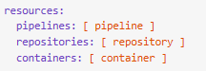
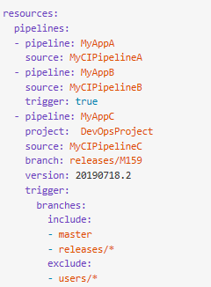
YAML resources
Pipelines
Containers
Repositories
Types

Slide 21

YAML resources
A resource is any external service that is consumed as part of your pipeline.

Slide 22
Using multiple repositories in your pipeline
Common for utilities used across more than one pipeline
Add additional checkout steps
Was not supported in earlier versions and artifacts were used as a workaround
Some pipelines might not need any repository

Slide 23
Lesson 05: Integrating external source control with Azure Pipelines

Slide 24
Source control types supported by Azure Pipelines
Repository types supported:
Repository Type | Azure Pipelines (YAML) | Azure Pipelines (Classic Editor)
Azure Repos Git | Yes | Yes
Azure Repos TFVC | No | Yes
Bitbucket Cloud | Yes | Yes
Other Git (Generic) | No | Yes
GitHub | Yes | Yes
GitHub Enterprise Server | Yes | Yes
Subversion | No | Yes

Slide 25
Lesson 06: Set up self-hosted agents

Slide 26
Communication with Azure Pipelines
The agent determines which job it needs to run, report the logs, and job status.
Communication is always initiated by the agent.
All the messages from the agent to Azure Pipelines are over HTTPS.
Azure Pipelines
Port 443
Agent on an on-premises machine behind firewall
Agent on a machine in cloud

Slide 27
Communication to deploy to target servers
Agent must have “line of sight” connectivity to servers.
Microsoft-hosted agent pools, by default, have connectivity to Azure websites and servers running in Azure.
You may need to manually configure connectivity.
Azure Pipelines service
Agent pools
Microsoft-hosted agents
Default
Hosted
1
2
3
4
Network firewall
X
No Line of Sight
Self-hosted agents
Target on-premises stages
1
2
3
4
Server1
Server2
Server3
Server4
Has line of sight, and so can deploy artifacts to these servers

Slide 28
Other considerations
Authentication
Personal Access Tokens
Interactive vs Service processes
Agent version and upgrades
Notes:
Do self-hosted agents have any performance advantages over Microsoft-hosted agents?
Can I install multiple self-hosted agents on the same machine?

Slide 29
Lesson 07: Labs

Slide 30
Lab: Enabling continuous integration with Azure Pipelines
Lab overview:
In this lab, you will learn how to configure continuous integration (CI) and continuous deployment (CD) for your applications using Build and Release in Azure Pipelines.
Objectives:
Create a basic build pipeline from a template
Track and review a build
Invoke a continuous integration build
Duration:
Notes:
The labs are updated on a regular basis. For the latest information please visit:
https://microsoftlearning.github.io/AZ400-DesigningandImplementingMicrosoftDevOpsSolutions/

Slide 31
Lab: Integrating external source control with Azure Pipelines
Lab overview:
In this lab, you’ll see how easy it is to set up Azure Pipelines with your GitHub projects and how you can start seeing benefits immediately.
Objectives:
Install Azure Pipelines from the GitHub Marketplace
Integrate a GitHub project with an Azure DevOps
pipeline
Track pull requests through the pipeline
Duration:
Notes:
The labs are updated on a regular basis. For the latest information please visit:
https://microsoftlearning.github.io/AZ400-DesigningandImplementingMicrosoftDevOpsSolutions/

Slide 32
Lesson 08: Module review and takeaways

Slide 33
What did you learn?
Explain why continuous integration matters.
Implement continuous integration using Azure DevOps.

Slide 34
Module review questions
1
Name the four pillars of continuous integration.
You want to take your build server offline to make a configuration change. You want it to complete any build that it is currently processing, but you want to queue any new build requests. What should you do?
2
3
You want to set a maximum time that builds should not run for more than 5 minutes. What configuration change should you make?
Notes:
Q1 Answer: The four pillars of continuous integration are: a Version Control System, Packet Management System, Continuous Integration System, and an Automated Build Process.
Q2 Answer: You should pause the build. A paused build will not start new builds and will queue any new build requests.
Q3 Answer: You should change the build job timeout setting to 5 minutes. A blank value means unlimited.

